Slide 1

INSTRUCTIONAL SUPPORT
Slides for Half-Earth Map Design Challenge

Slide 2
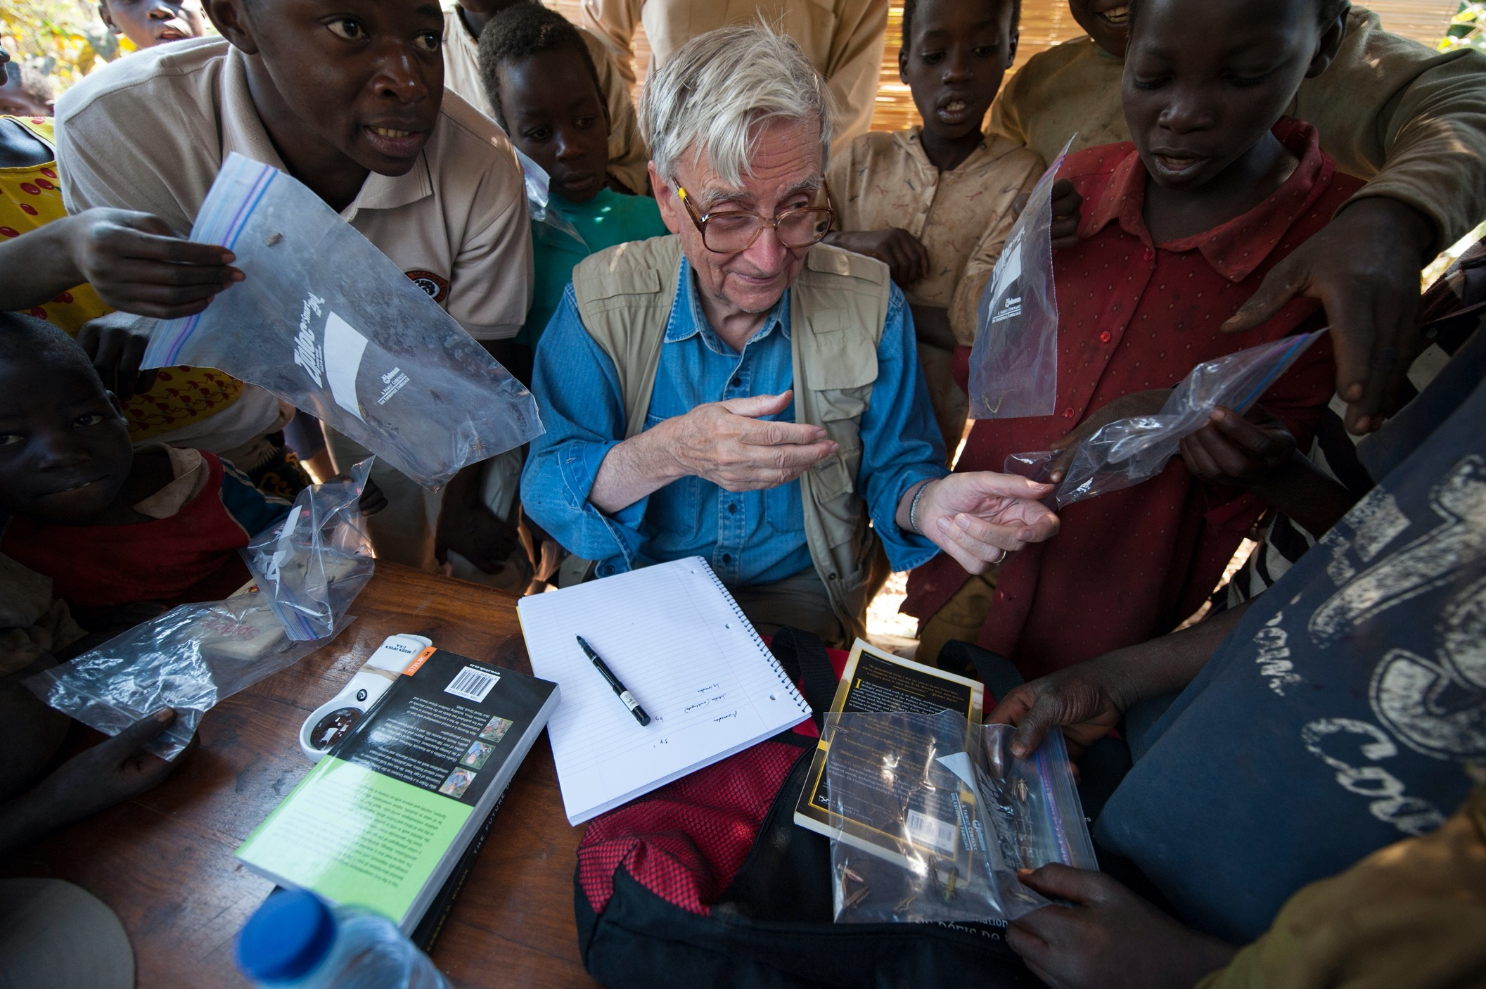
“…the only solution to the sixth extinction is to increase the area of inviolable natural reserves to half the surface of Earth or greater.”
“… species is the unit of biodiversity that can and must be studied most thoroughly with the practical aim of saving the whole.”
– E.O. WILSON

Slide 3
Why Half?

Slide 4





HALF-EARTH DAY EDUCATOR AMBASSADOR WORKSHOP
Let’s Break the Ice
This room is a map of the US.
Go to the first place that you lived in the US.
Think of your favorite place in the US. Go there.

Slide 5
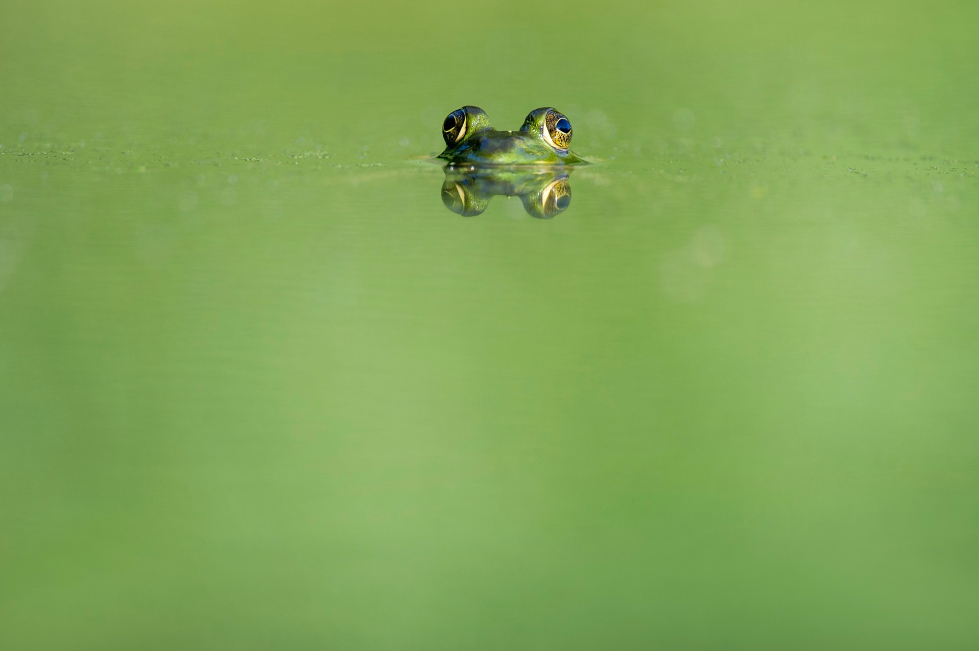
“…the only solution to the sixth extinction is to increase the area of inviolable natural reserves to half the surface of Earth or greater.”
– E.O. WILSON

Slide 6
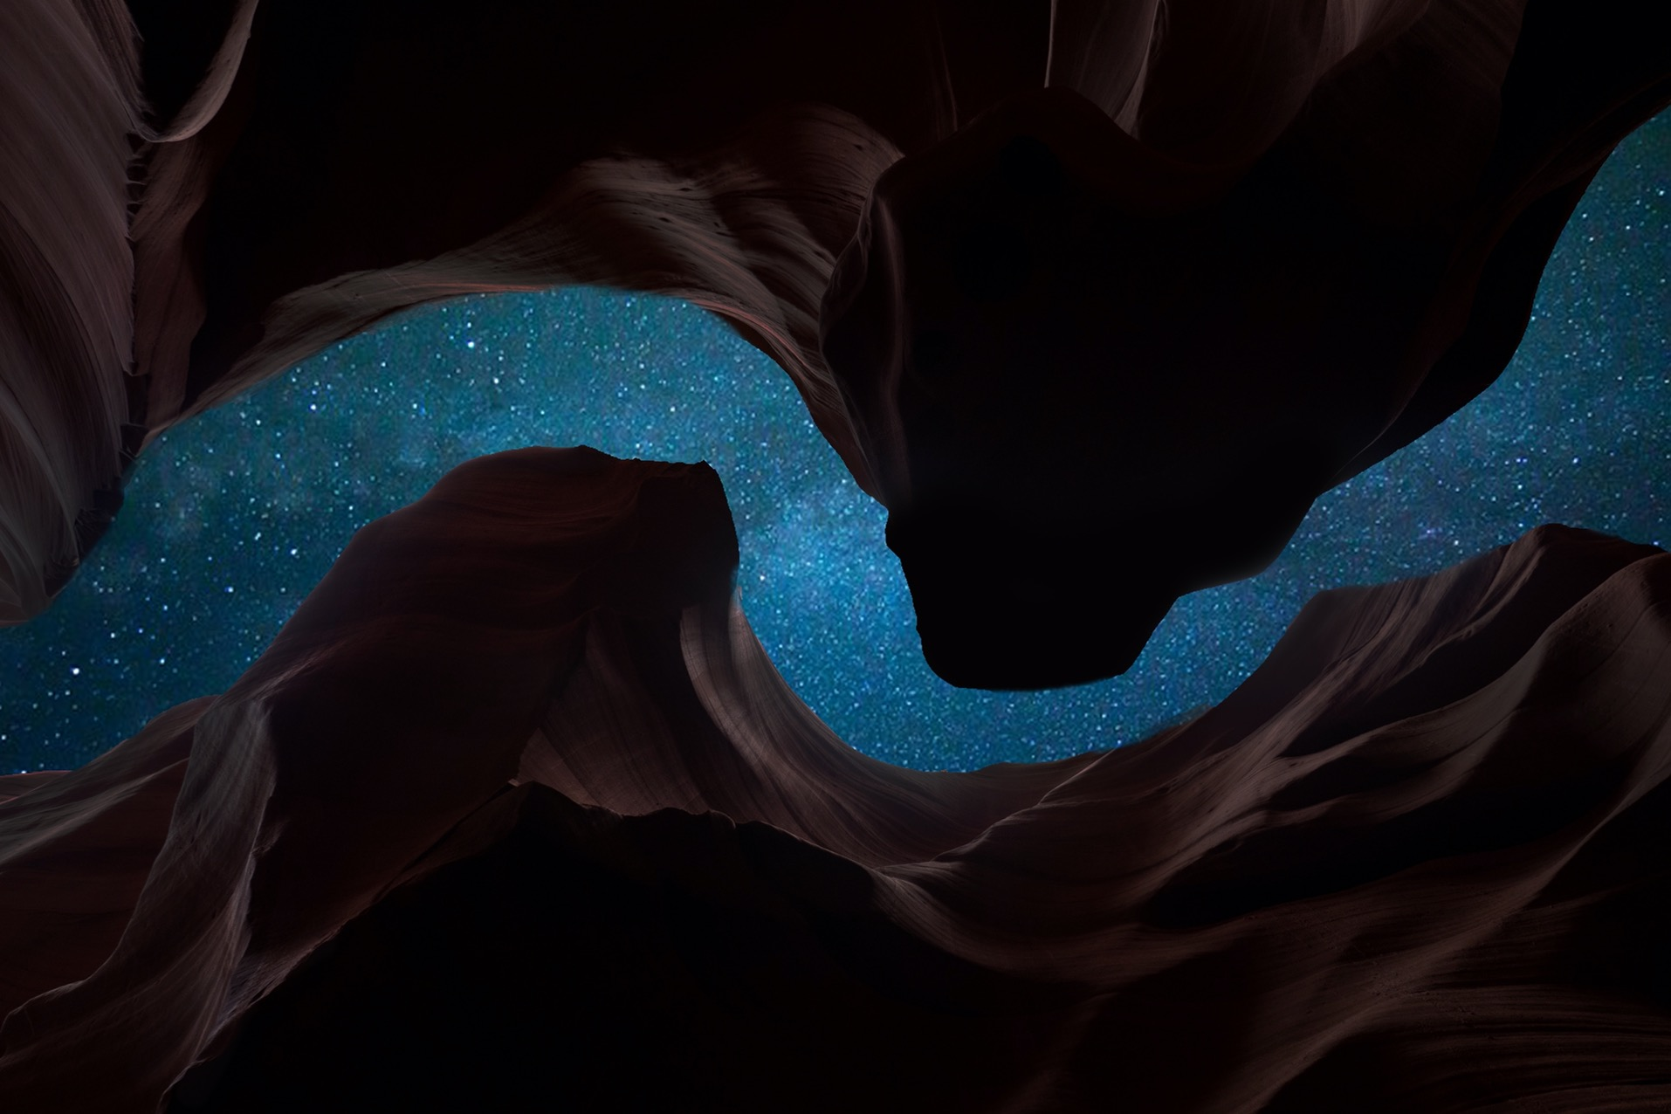
IUCN — INTERNATIONAL UNION FOR THE CONSERVATION OF NATURE
A protected area is a clearly defined geographical space, recognized, dedicated and managed, through legal or other effective means, to achieve the long term conservation of nature with associated ecosystem services and cultural values.

Slide 7
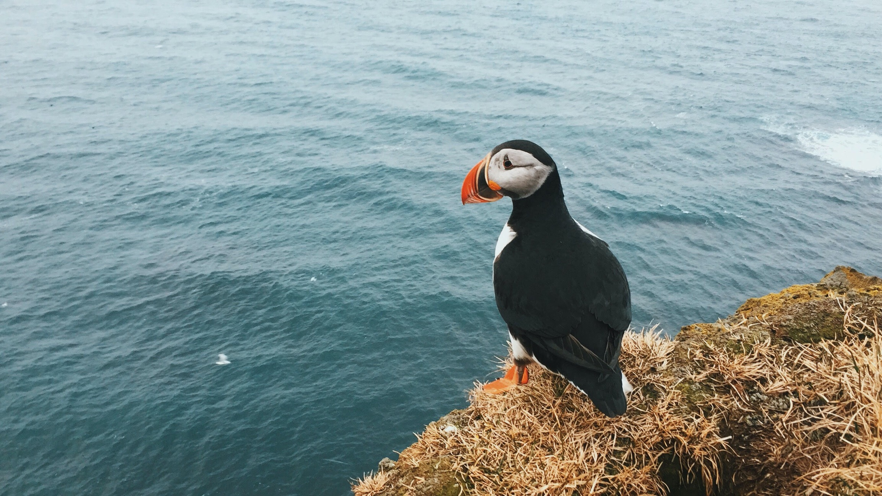
IUCN PROTECTED AREA PARAMETERS
Valuing and conserving biodiversity
Governing nature’s use and sharing its benefits equitably
Deploying nature-based solutions to global challenges
Respecting people

Slide 8
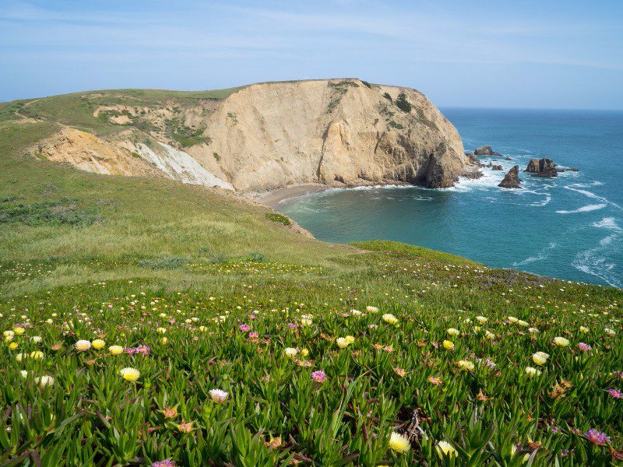
PROTECTED AREAS INCLUDE
Nature Reserves
Wilderness Areas
National Parks
Natural Monument
Habitat or Species Management Area
Protected Landscape or Seascape
Protected area with sustainable use of natural resources

Slide 9
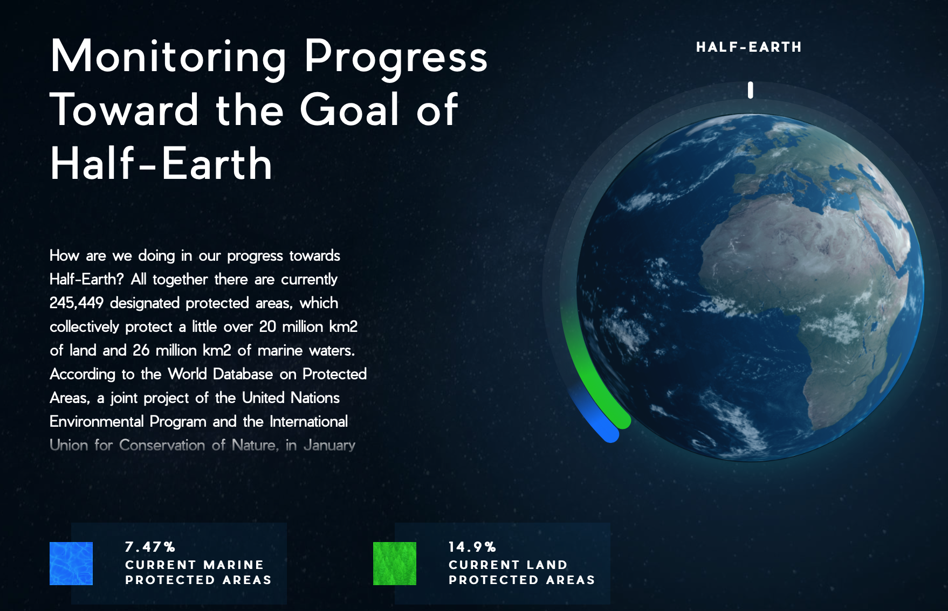

Slide 10
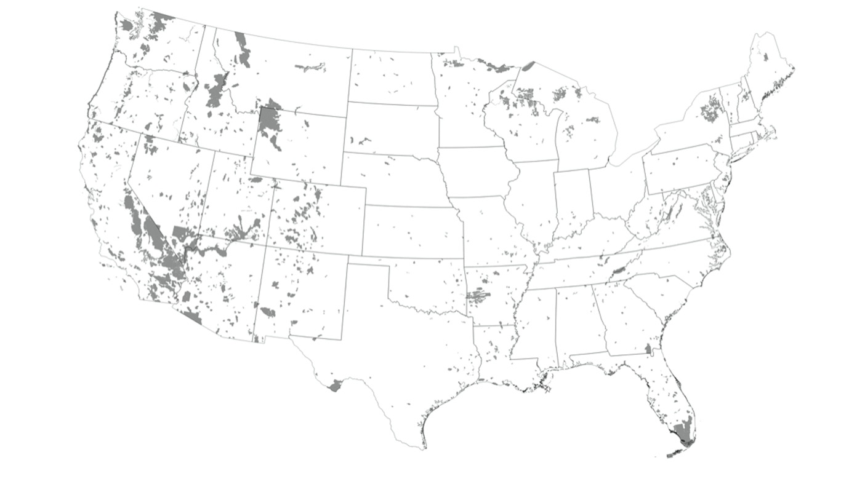

PROTECTED AREAS
Source: Protected Areas Database

Slide 11
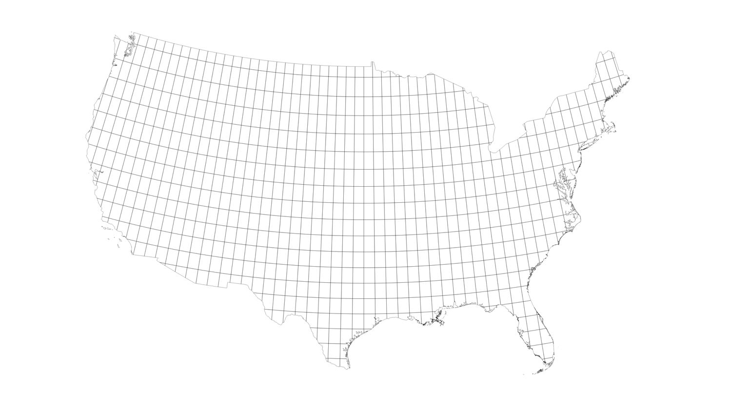
GRID MAP

Slide 12

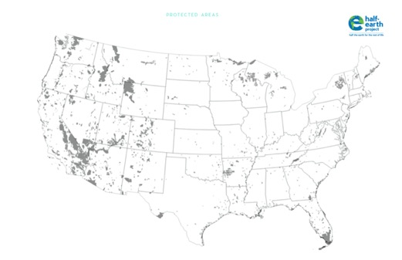
WHAT PROPORTION OF US PROTECTED?
Part 1 Directions
Place your grid map over your protected areas map.
Use a marker to dot the grid cells that are protected.
Time - 10 minutes

Slide 13
WHAT PROPORTION OF US PROTECTED?
Count your marked grid cells
The total number of grid cells is 738
Calculate the % of our lands currently protected
Share out!
The person in your group with the shortest hair!
Time - 2 minutes

Slide 14
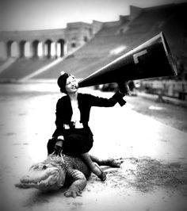
COLLATE AND SHARE RESULTS
Did teams all get the same estimate of US protected lands?
Why or why not?

Slide 15
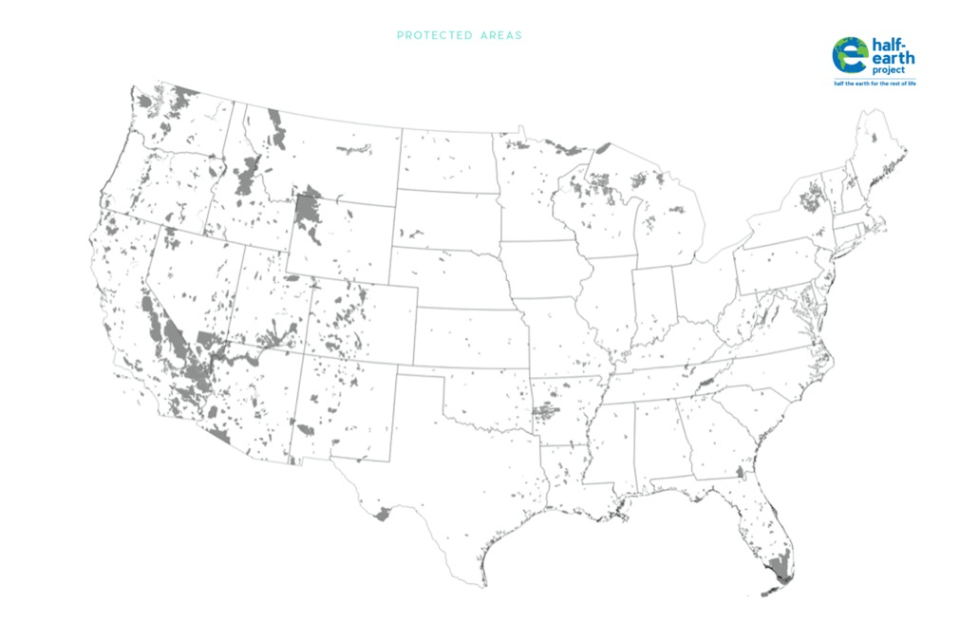
MAKING CONSERVATION DECISIONS
Turn and Talk
Choose ONE CELL you would like to add into “protected land” on
Explain to your elbow partner WHY you want to protect this area.
Time - 10 minutes
Source: Protected Areas Database

Slide 16
MAKING CONSERVATION DECISIONS
SHARE OUT!
Person who had the most recent birthday.
Source: Protected Areas Database

Slide 17
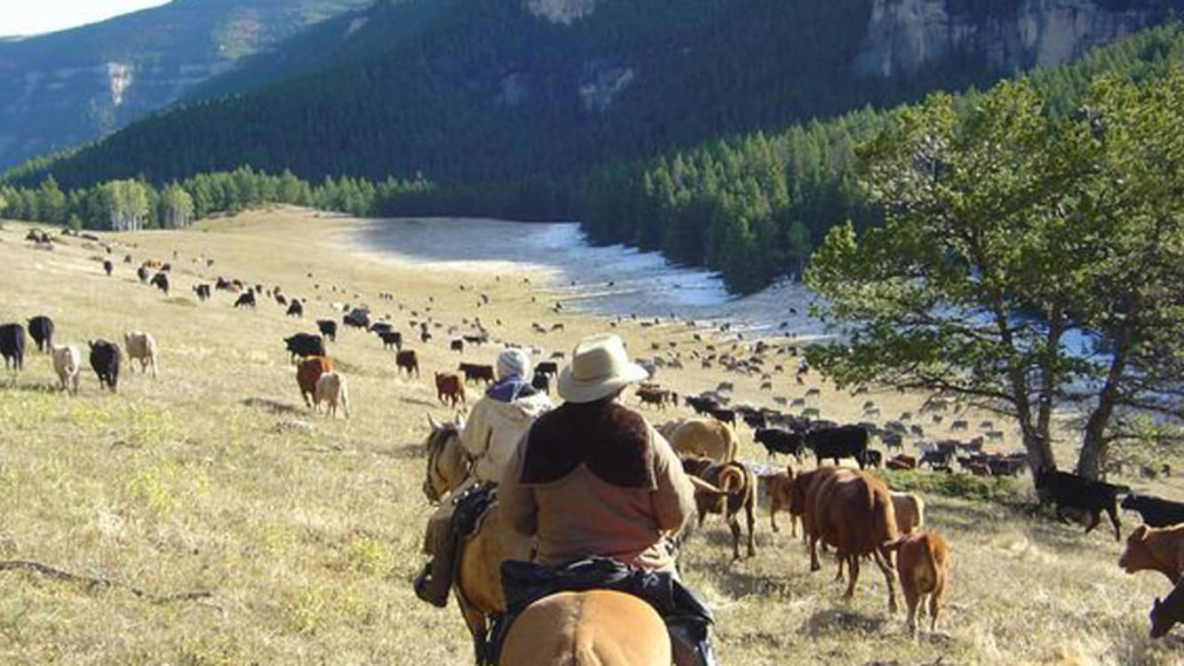
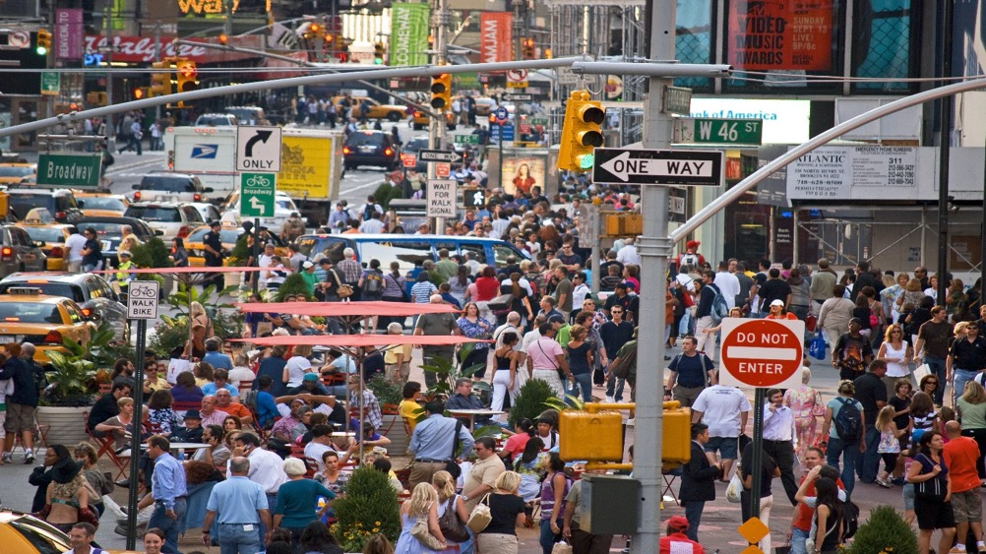

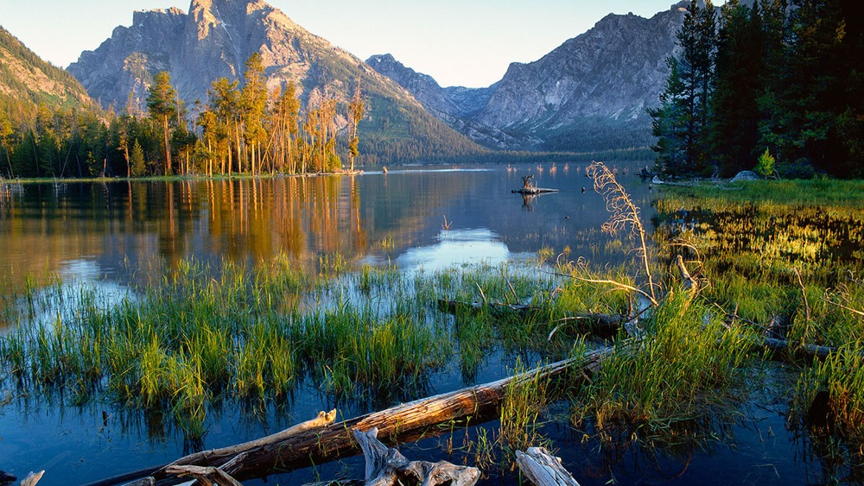

Slide 18
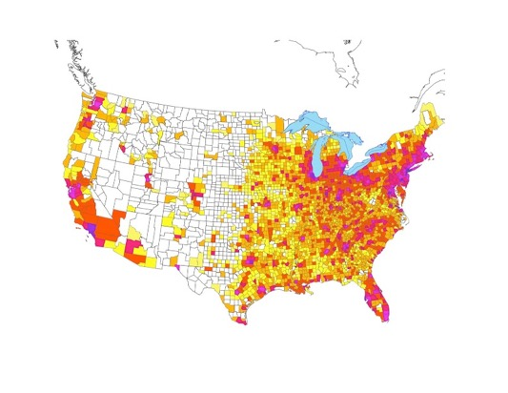
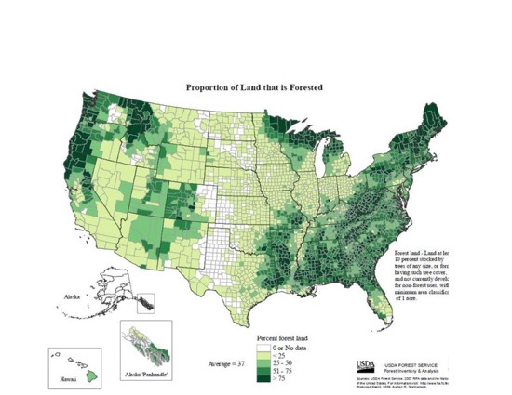
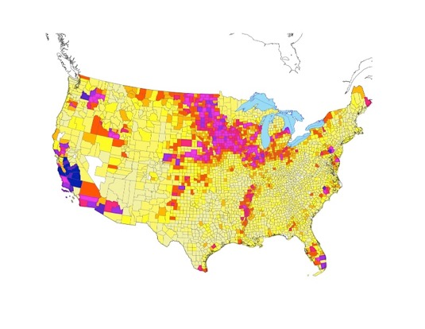
THINK HALF-EARTH – ACT LOCAL
DESIGN CHALLENGE Work as a team to place half of US land into protected status.
DESIGN CONSTRAINTS
Maximize biodiversity and sustainability.
Look at your maps, and think about how they address biodiversity and human needs.
Place a dot on each cell you want to protect.
You have 15 minutes starting now.

Slide 19
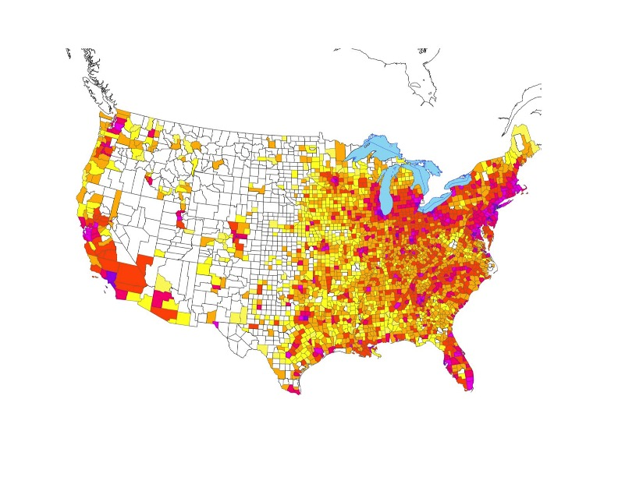
POPULATION DENSITY BY COUNTY
Scale of heatmap: lightest to darkest red
0-10 per square mile
10-100
100-500
500-1000
1000-68,000
Source: 2000 US Census

Slide 20

AGRICULTURAL INTENSITY BY COUNTY
Avg. value of agricultural products sold in 2012
Less than $10,000/farm
$10,000 - 99,000
$100,000 - 249,999
$250,000 - 499,999
$500,000 – 749,999
$750,00 +
Source: 2012 USDA

Slide 21
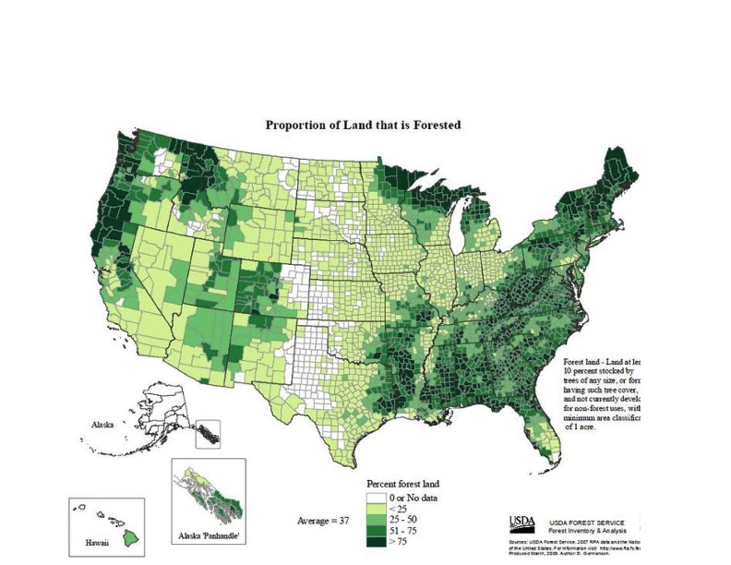
PROPORTION OF LAND THAT IS FORESTED

Slide 22
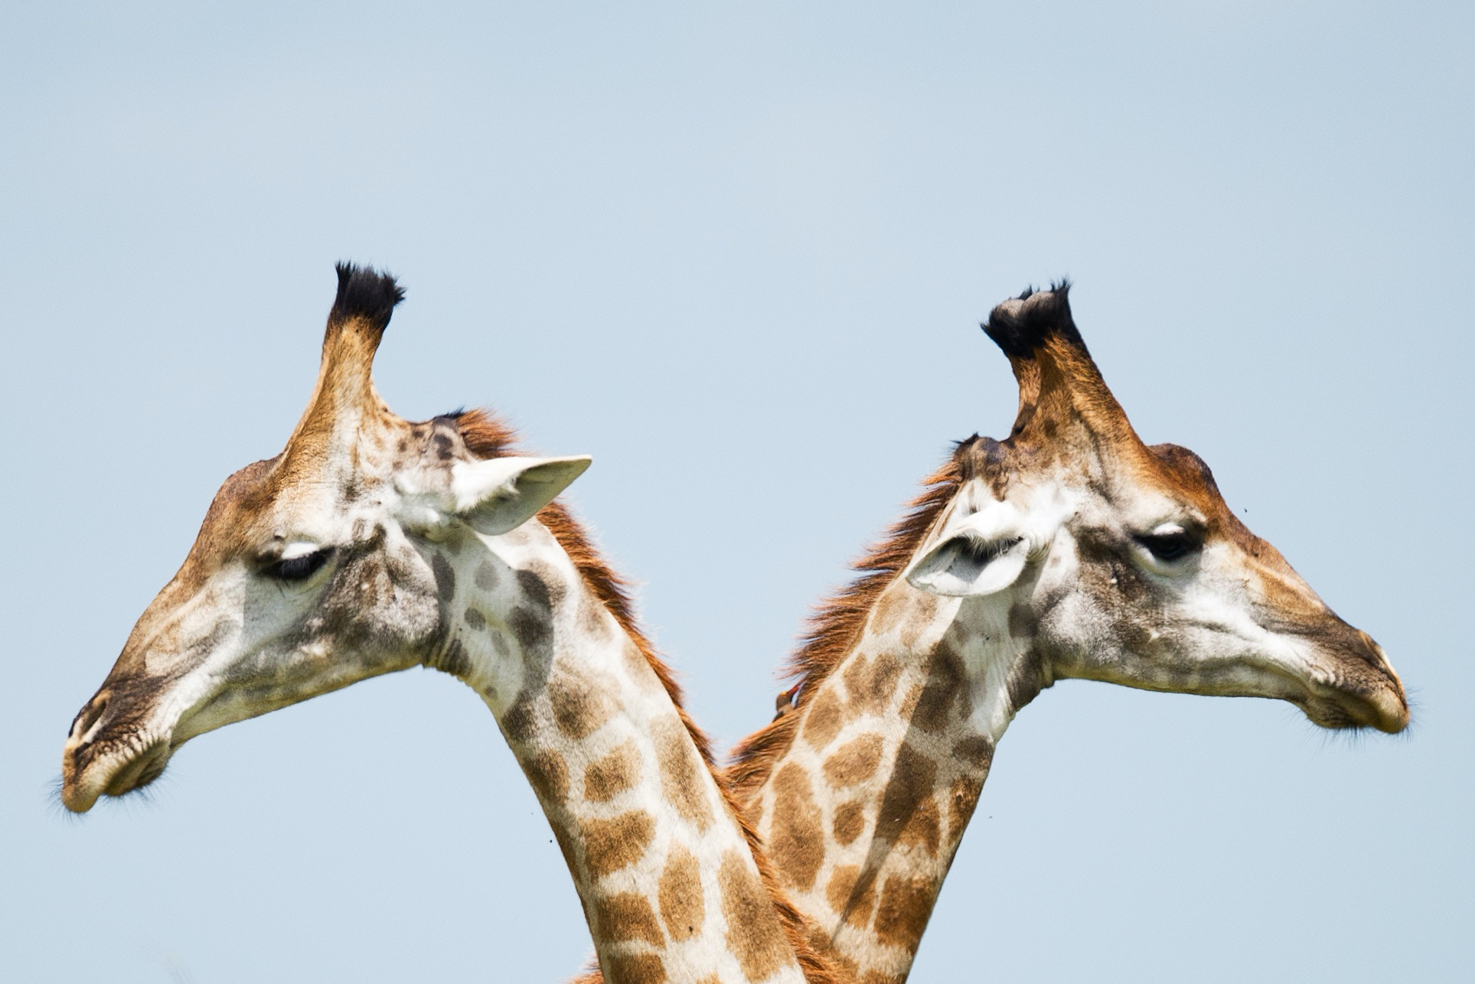
Trade maps with another group.
PEER COLLABORATION

Slide 23
PEER COLLABORATION
Analyze the newly protected map from another group.
Pick a cell where you think both biodiversity and sustainability were optimized.
Pick a cell where you feel the costs out-weighed the benefits.

Slide 24
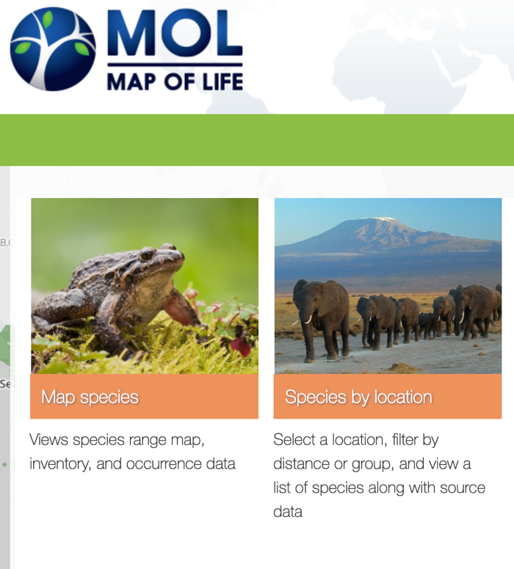
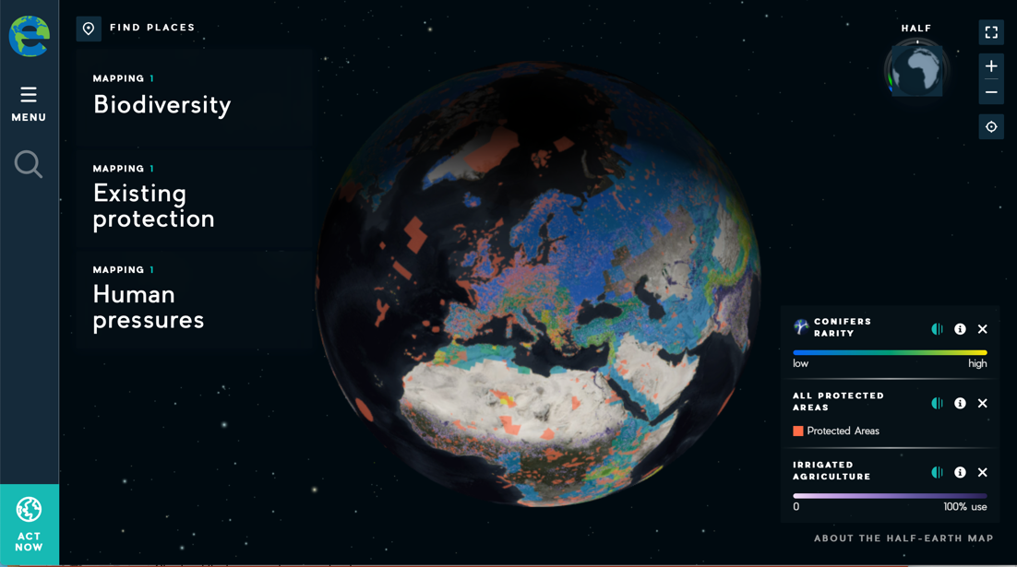
DIGITAL RESOURCES THAT FOCUS ON BIODIVERSITY
The Half-Earth Map

Slide 25
DEVELOPMENT TEAM
Dennis Liu
Amanda Briody
Leslie Ries
Chris Heltne
Nicole Hance
Copyright: Half-Earth Project
& E.O. Wilson Biodiversity Foundation, 2020

